Slide 1

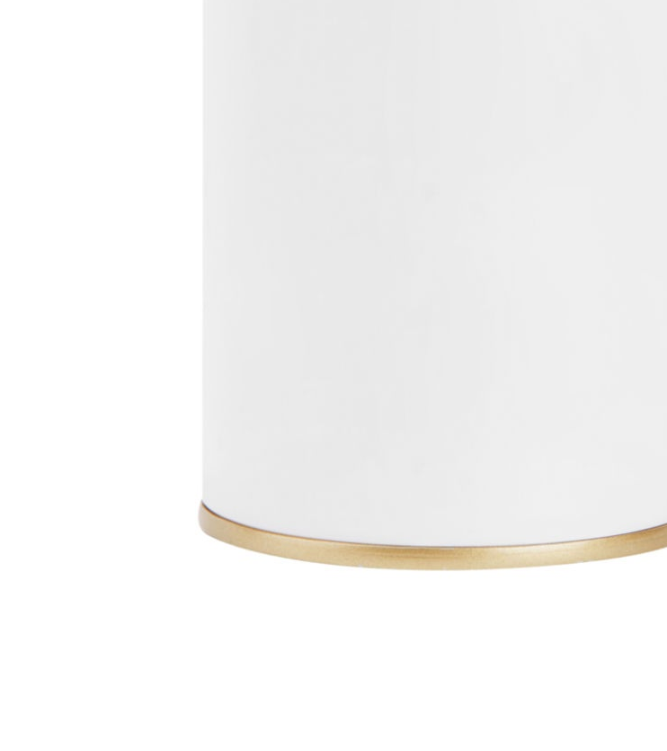

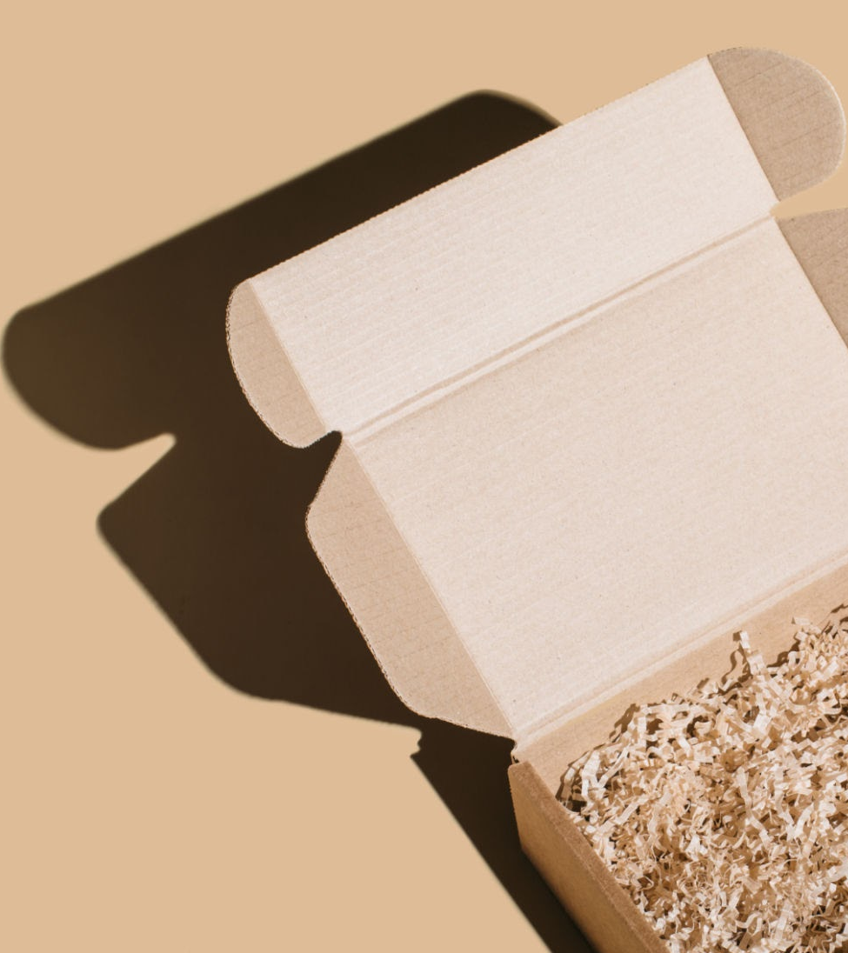
Nykaa
Analysis

Slide 2
Introduction to Nykaa:
Overview:
Founded in 2012, by Falguni Nayar. Nykaa has established itself as an India’s largest omnichannel beauty destination and India’s first Ecommerce platform.
Mission:
To create a world where customers have access to a finely curated, authentic assortment of products and services that delight and elevate the human spirit.

Slide 3
Nykaa Business Model:
Nykaa is a direct to consumer e-commerce brand that incorporates an inventory based strategy. It has offers over 2,000 brands and 2,00,000 products. The company purchases a variety of products across different product ranges directly from manufacturers.
Expanded its business in 2015 by moving from an online-only model to an omnichannel model by opening its first offline store and selling products other than beauty.

Slide 4
Nykaa Revenue Model (2023-2024):
Total Operating Revenue
(2023-2024):INR 6,386 cr
PRODUCT SALES(2023-2024) Revenue: INR 1,875 cr
PRODUCT SALES: contribution to operating Revenue- 29%

Slide 5
Technology Utilization:
Cloud services:
Leveraging Amazon web services (AWS) for scalability and performance.
HTML5, Lightbox and Nudgespot including other technologies used by Nykaa to store data.
Impact of Technology:
Enhances operational efficiency and supports large scale data processing
Enables personalized customer experience and real time analytics.

Slide 6
Market Position and Growth:
Market Position:
Competes with giants like Myntra, Tata cliq, Purplle.com, Reliance Tiara etc..
Holds a significant share in India’s growing online beauty market.
Growth Trajectory:
Started with modest initial investment and rapidly scaled operations
First physical store in Delhi to complement online presence and expanded to 120 stores across India.

Slide 7
SWOT Analysis of Nykaa:
Strengths:
Product range, Pricing, Geographical presence, Quality of products, Suppliers network, Social media interaction etc..
Weakness:
Employee satisfaction, Delivery charges,Marketing Budget, Waste Management, etc..
Opportunities:
Technological enhancement, Standard of living, E-commerce and Networking, Rapidly changing preferences, etc..
Threats:
E-commerce regulations, The rise in competitors, Environmental concerns, Covid 19 pandemic, etc..

Slide 8

Marketing strategies:
Digital Marketing and Content creation.
Influencer Collaborations.
Social Media engagement.
Omnichannel presence.
Exclusive Brand Partnerships.
Event marketing

Slide 9
Current market fashion trends:
Nostalgia meets innovation.
Sustainability and Ethical choice.
Technological integration.
Comfort and functionality.
Cultural Fusion
Comparison of Current Market Trends in Fashion and Nykaa Fashion Trends:
Overlap
Differences
Strategic gaps for Nykaa fashion.

Slide 10
Comparative Analysis of Nykaa and it’s competitors.
Challenges and Considerations:
Intensifying competitions.
Supply chain and distribution.
Market penetration beyond urban areas.
Strategic Opportunities:
Expansion into emerging markets.
Focus on sustainable and Natural products.
Enhancing technological integration.

Slide 11
Customer Review Analysis:
Methodology:
Analyzed Social media platforms (Youtube, Instagram, Facebook) by using ChatGpt.
Categorised reviews into Positive and Negative reviews.
Findings:
Positive comments praising affordability and quality, product availability, pricing,etc...
Negative feedback on certain products causing discomfort, customer service and delivery issues,etc..

Slide 12
Strategic Recommendations
Leverage Positive Reviews.
Address Negative Reviews.
Strengthen Customer Engagement.
Product Development Insights.
Improve Communication Channels.
Measure and Adapt.

Slide 13
THANK YOU.

